Slide 1
Gradient Descent
Notes:
Stochastic
Data normalization
Mine ,,,,,,

Slide 2
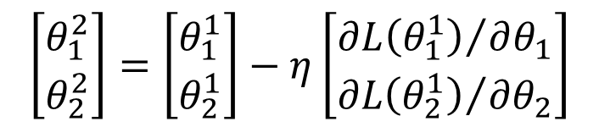
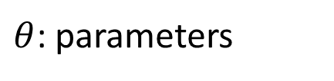


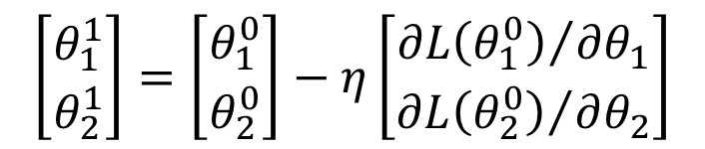
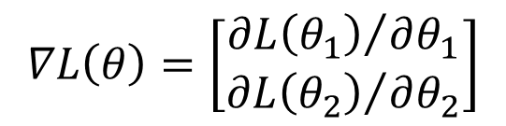
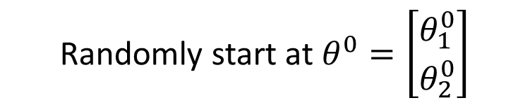

Review: Gradient Descent
In step 3, we have to solve the following optimization problem:
$$θ^{∗}=arg\min_{θ}{L\left(θ\right)}$$
L: loss function
$θ$: parameters
Suppose that θ has two variables {θ₁, θ₂}
Randomly start at $θ^{0}=\left[\begin{matrix}θ_{1}^{0} \\ θ_{2}^{0}\end{matrix}\right]$
$$∇L\left(θ\right)=\left[\begin{matrix}{∂L\left(θ_{1}\right)}/{∂θ_{1}} \\ {∂L\left(θ_{2}\right)}/{∂θ_{2}}\end{matrix}\right]$$
$$\left[\begin{matrix}θ_{1}^{1} \\ θ_{2}^{1}\end{matrix}\right]=\left[\begin{matrix}θ_{1}^{0} \\ θ_{2}^{0}\end{matrix}\right]−η\left[\begin{matrix}{∂L\left(θ_{1}^{0}\right)}/{∂θ_{1}} \\ {∂L\left(θ_{2}^{0}\right)}/{∂θ_{2}}\end{matrix}\right]$$
$$θ^{1}=θ^{0}−η∇L\left(θ^{0}\right)$$
$$\left[\begin{matrix}θ_{1}^{2} \\ θ_{2}^{2}\end{matrix}\right]=\left[\begin{matrix}θ_{1}^{1} \\ θ_{2}^{1}\end{matrix}\right]−η\left[\begin{matrix}{∂L\left(θ_{1}^{1}\right)}/{∂θ_{1}} \\ {∂L\left(θ_{2}^{1}\right)}/{∂θ_{2}}\end{matrix}\right]$$
$$θ^{2}=θ^{1}−η∇L\left(θ^{1}\right)$$

Slide 3





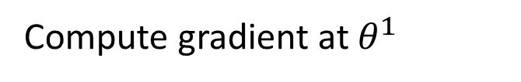


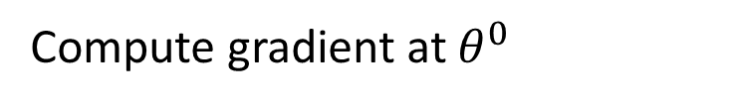

Review: Gradient Descent
$$θ_{2}$$
Gradient: Loss 的等高線的法線方向
$$∇L\left(θ^{0}\right)$$
Start at position $θ^{0}$
$$θ^{0}$$
$$∇L\left(θ^{1}\right)$$
Compute gradient at $θ^{0}$
$$θ^{1}$$
$$∇L\left(θ^{2}\right)$$
Move to $θ^{1}$ = $θ^{0}$ - η$∇L\left(θ^{0}\right)$
$$θ^{2}$$
Gradient
Compute gradient at $θ^{1}$
Movement
$$∇L\left(θ^{3}\right)$$
$$θ^{3}$$
Move to $θ^{2}$ = $θ^{1}$ – η$∇L\left(θ^{1}\right)$
……
$$θ_{1}$$
Notes:
Draw is so comply use minecraft
Easy for more than two variables

Slide 4
Gradient Descent
Tip 1: Tuning your
learning rates

Slide 5
Learning Rate
Set the learning rate η carefully
If there are more than three parameters, you cannot visualize this.
Loss
Very Large
small
Large
Loss
Just make
No. of parameters updates
But you can always visualize this.

Slide 6
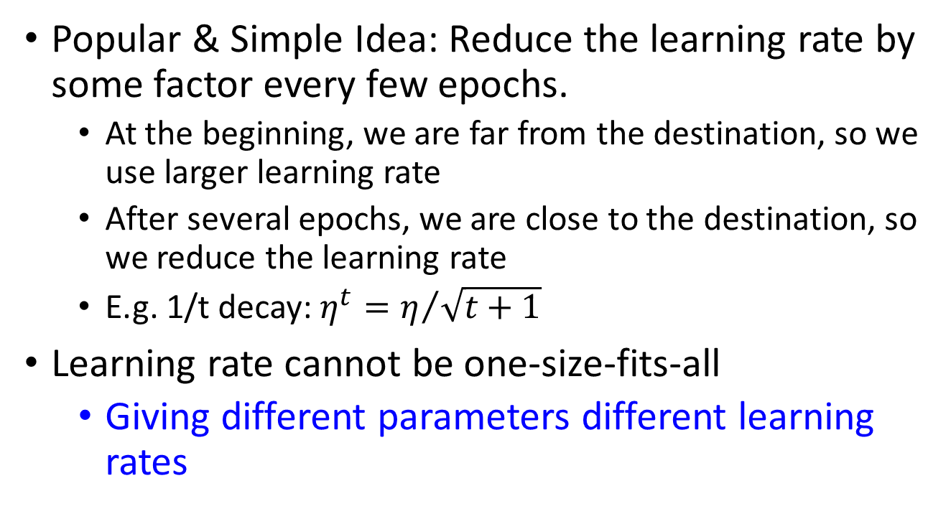
Adaptive Learning Rates
Popular & Simple Idea: Reduce the learning rate by some factor every few epochs.
At the beginning, we are far from the destination, so we use larger learning rate
After several epochs, we are close to the destination, so we reduce the learning rate
E.g. 1/t decay: $η^{t}=η/{\sqrt{t+1}}$
Learning rate cannot be one-size-fits-all
Giving different parameters different learning rates
Notes:
Advanced Idea: Eta
Can we give each parameters different learning rates?

Slide 7

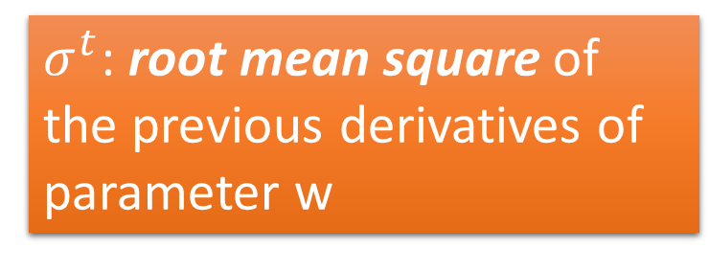
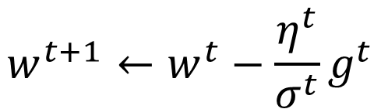


Adagrad
$$η^{t}=\frac{η}{\sqrt{t+1}}$$
$$g^{t}=\frac{∂L\left(θ^{t}\right)}{∂w}$$
Divide the learning rate of each parameter by the root mean square of its previous derivatives
Vanilla Gradient descent
$$w^{t+1}←w^{t}−{\text{η}}^{t}g^{t}$$
w is one parameters
Adagrad
$σ^{t}$: root mean square of the previous derivatives of parameter w
$$w^{t+1}←w^{t}−\frac{{\text{η}}^{t}}{σ^{t}}g^{t}$$
Parameter dependent

Slide 8
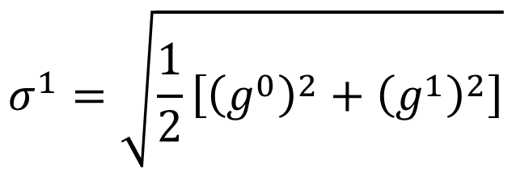
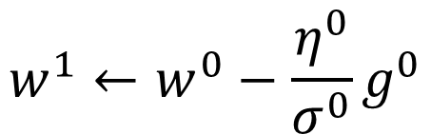


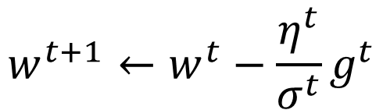
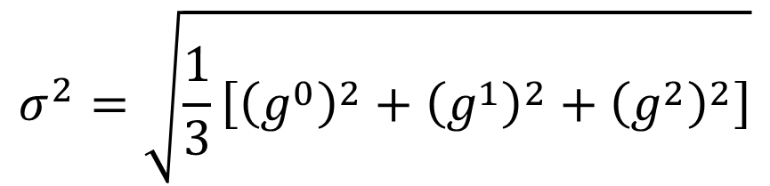
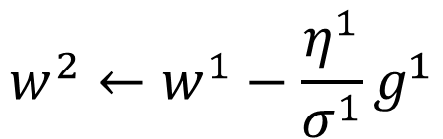
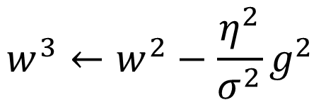

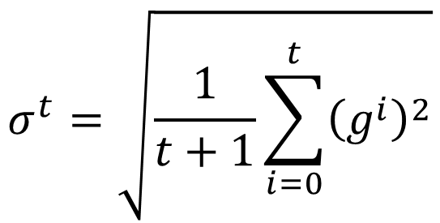
Adagrad
$σ^{t}$: root mean square of the previous derivatives of parameter w
$$w^{1}←w^{0}−\frac{{\text{η}}^{0}}{σ^{0}}g^{0}$$
$$σ^{0}=\sqrt{{\left(g^{0}\right)}^{2}}$$
$$σ^{1}=\sqrt{\frac{1}{2}\left[{\left(g^{0}\right)}^{2}+{\left(g^{1}\right)}^{2}\right]}$$
$$w^{2}←w^{1}−\frac{{\text{η}}^{1}}{σ^{1}}g^{1}$$
$$σ^{2}=\sqrt{\frac{1}{3}\left[{\left(g^{0}\right)}^{2}+{\left(g^{1}\right)}^{2}+{\left(g^{2}\right)}^{2}\right]}$$
$$w^{3}←w^{2}−\frac{{\text{η}}^{2}}{σ^{2}}g^{2}$$
$$……$$
$$σ^{t}=\sqrt{\frac{1}{t+1}\sum_{i=0}^{t}{{\left(g^{i}\right)}^{2}}}$$
$$w^{t+1}←w^{t}−\frac{{\text{η}}^{t}}{σ^{t}}g^{t}$$
Notes:
Why square

Slide 9




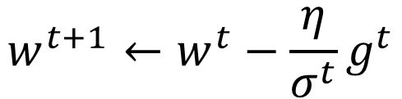
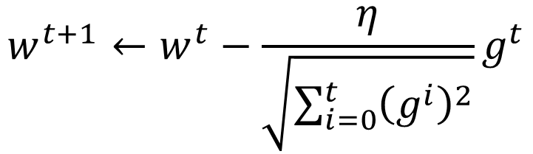
Adagrad
Divide the learning rate of each parameter by the root mean square of its previous derivatives
$$η^{t}=\frac{η}{\sqrt{t+1}}$$
1/t decay
$${\text{η}}^{t}$$
$$w^{t+1}←w^{t}−\frac{η}{σ^{t}}g^{t}$$
$$σ^{t}=\sqrt{\frac{1}{t+1}\sum_{i=0}^{t}{{\left(g^{i}\right)}^{2}}}$$
$$σ^{t}$$
$$w^{t+1}←w^{t}−\frac{η}{\sqrt{\sum_{i=0}^{t}{{\left(g^{i}\right)}^{2}}}}g^{t}$$

Slide 10

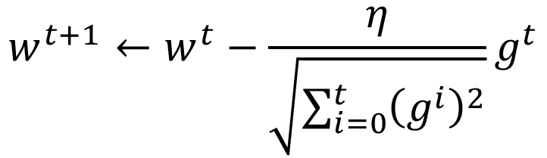


Contradiction?
$$η^{t}=\frac{η}{\sqrt{t+1}}$$
$$g^{t}=\frac{∂L\left(θ^{t}\right)}{∂w}$$
Vanilla Gradient descent
Larger gradient,
larger step
$$w^{t+1}←w^{t}−{\text{η}}^{t}g^{t}$$
Adagrad
Larger gradient,
larger step
$$w^{t+1}←w^{t}−\frac{η}{\sqrt{\sum_{i=0}^{t}{{\left(g^{i}\right)}^{2}}}}g^{t}$$
Larger gradient, smaller step
Notes:
Contradiction??????

Slide 11
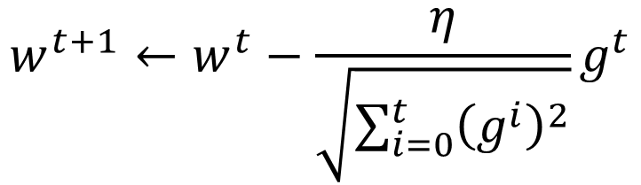


Intuitive Reason
$$η^{t}=\frac{η}{\sqrt{t+1}}$$
$$g^{t}=\frac{∂L\left(θ^{t}\right)}{∂w}$$
How surprise it is
反差
特別大
g⁰ | g¹ | g² | g³ | g⁴ | ……
0.001 | 0.001 | 0.003 | 0.002 | 0.1 | ……
g⁰ | g¹ | g² | g³ | g⁴ | ……
10.8 | 20.9 | 31.7 | 12.1 | 0.1 | ……
特別小
$$w^{t+1}←w^{t}−\frac{η}{\sqrt{\sum_{i=0}^{t}{{\left(g^{i}\right)}^{2}}}}g^{t}$$
造成反差的效果
Notes:
http://seed.ucsd.edu/mediawiki/images/6/6a/Adagrad.pdf
http://courses.cs.washington.edu/courses/cse547/15sp/slides/adagrad.pdf
Some features can be extremely useful and informative to an optimization problem but they may not show up in most of the training instances or data. If, when they do show up, they are weighted equally in terms of learning rate as a feature that has shown up hundreds of times we are practically saying that the influence of such features means nothing in the overall optimization (it's impact per step in the stochastic gradient descent will be so small that it can practically be discounted). To counter this, AdaGrad makes it such that features that are more sparse in the data have a higher learning rate which translates into a larger update for that feature (i.e. in logistic regression that feature's regression coefficient will be increased/decreased more than a coefficient of a feature that is seen very often). Simply put, sparse features can be very useful. I don't have an example of application in neural network training. Different adaptive learning algorithms are useful with different data (it would really depend on what your data is and how much importance you place on sparse features).

Slide 12
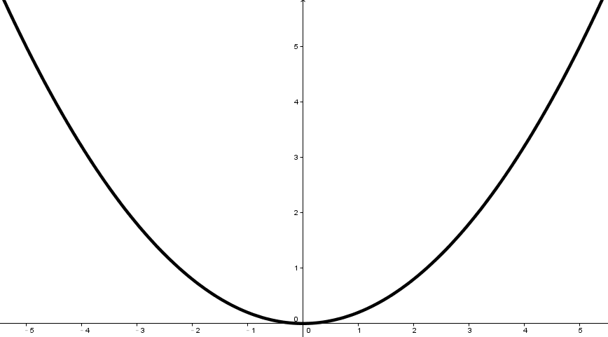
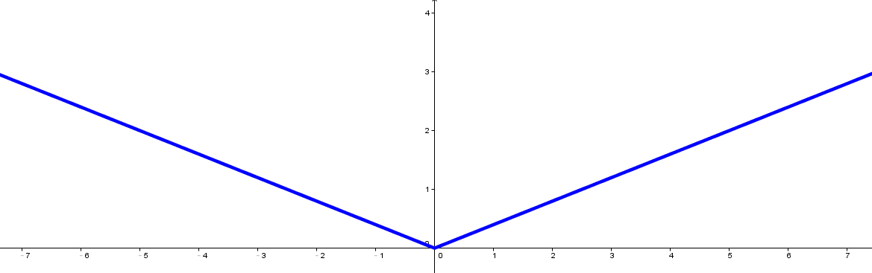


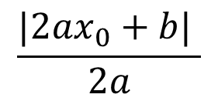





Larger gradient, larger steps?
Best step:
$$|x_{0}+\frac{b}{2a}|$$
$$\frac{|2ax_{0}+b| }{2a}$$
Larger 1st order derivative means far from the minima
$$x_{0}$$
$$−\frac{b}{2a}$$
$$y=ax^{2}+bx+c$$
$$|2ax_{0}+b|$$
$$\left|\frac{∂y}{∂x}\right|=|2ax+b|$$
$$x_{0}$$

Slide 13
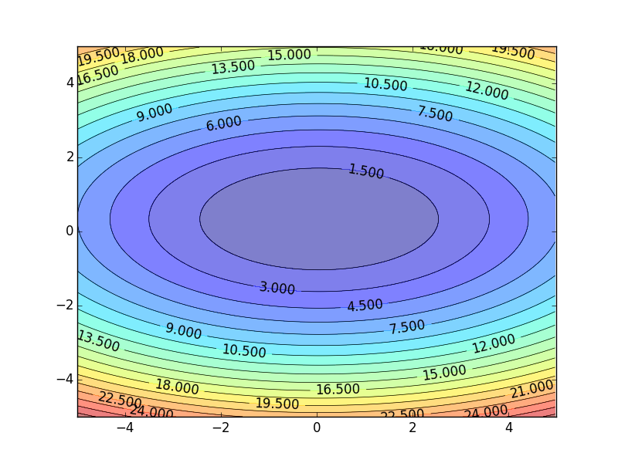
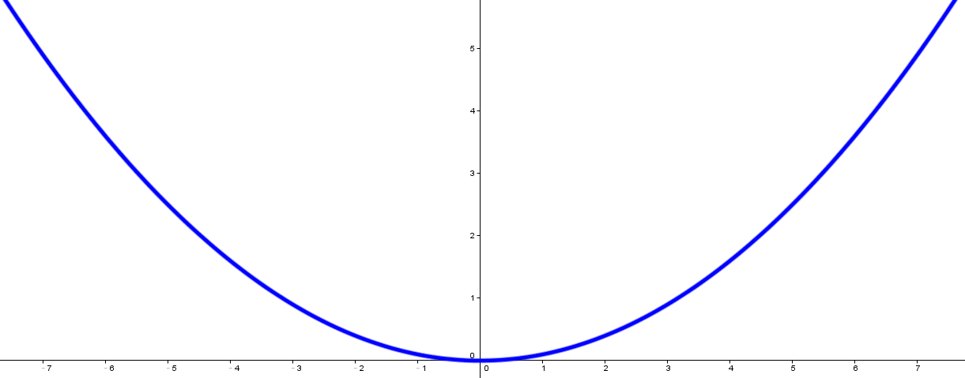
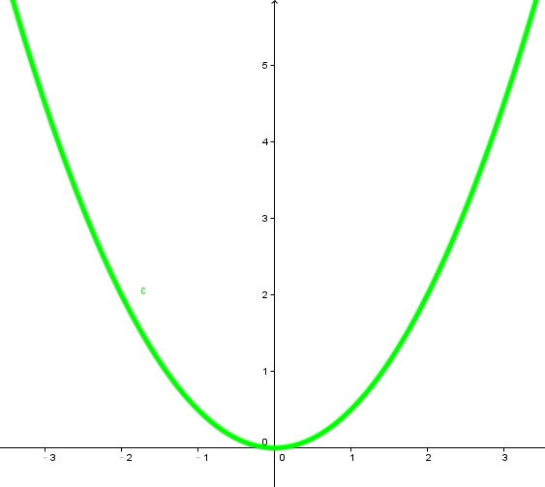




Comparison between different parameters
Larger 1st order derivative means far from the minima
Do not cross parameters
a > b
a
b
$$w_{1}$$
$$w_{2}$$
c
c > d
d
$$w_{1}$$
$$w_{2}$$
Notes:
Larger Gradient
Smaller Learning
Rate

Slide 14

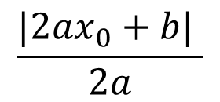

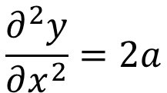





Second Derivative
Best step:
$$|x_{0}+\frac{b}{2a}|$$
$$\frac{|2ax_{0}+b| }{2a}$$
$$−\frac{b}{2a}$$
$$x_{0}$$
$$y=ax^{2}+bx+c$$
$$|2ax_{0}+b|$$
$$\left|\frac{∂y}{∂x}\right|=|2ax+b|$$
$$x_{0}$$
$$\frac{∂^{2}y}{∂x^{2}}=2a$$
|First derivative|
The best step is
Second derivative
Notes:
You will ignore it in this case,
Because the second is always the saem
For taylor, second order is consdierd

Slide 15
Comparison between different parameters
Larger 1st order derivative means far from the minima
Do not cross parameters
|First derivative|
The best step is
Second derivative
a > b
Larger
Second
a
b
$$w_{1}$$
smaller second derivative
$$w_{2}$$
c
c > d
Smaller
Second
d
$$w_{1}$$
$$w_{2}$$
Larger second derivative
Notes:
Larger Gradient
Smaller Learning
Rate

Slide 16
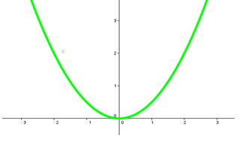
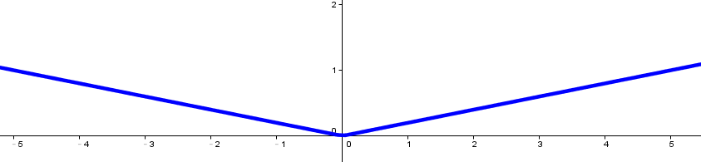
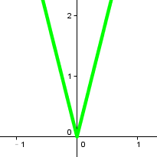


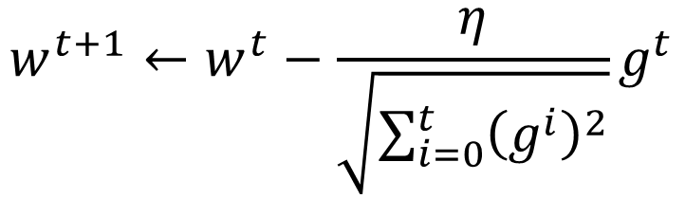

The best step is
$$w^{t+1}←w^{t}−\frac{η}{\sqrt{\sum_{i=0}^{t}{{\left(g^{i}\right)}^{2}}}}g^{t}$$
|First derivative|
Second derivative
?
Use first derivative to estimate second derivative
larger second derivative
smaller second derivative
$$w_{1}$$
$$w_{2}$$
$$\sqrt{{\left(first derivative\right)}^{2}}$$
Notes:
What would you see?

Slide 17
Gradient Descent
Tip 2: Stochastic
Gradient Descent
Make the training faster

Slide 18
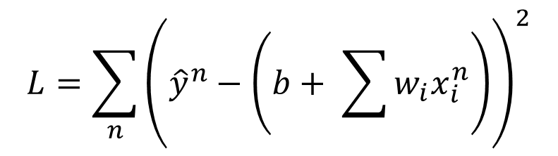
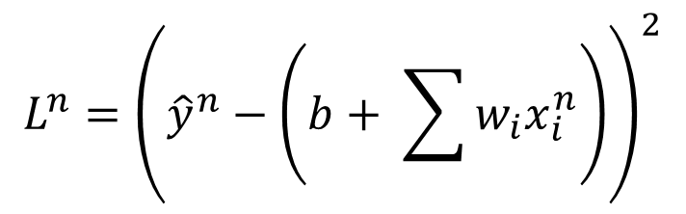
Stochastic Gradient Descent
$$L=\sum_{n}{{\left({\hat{y}}^{n}−\left(b+ \sum{w_{i}x_{i}^{n}}\right)\right)}^{2}}$$
Loss is the summation over all training examples
Gradient Descent
Stochastic Gradient Descent
Faster!
Pick an example x^{n}
$$L^{n}={\left({\hat{y}}^{n}−\left(b+ \sum{w_{i}x_{i}^{n}}\right)\right)}^{2}$$
Loss for only one example
Notes:
See all the examples once = 1 epoch
Two approaches update the parameters towards the same direction, but stochastic is faster!

Slide 19
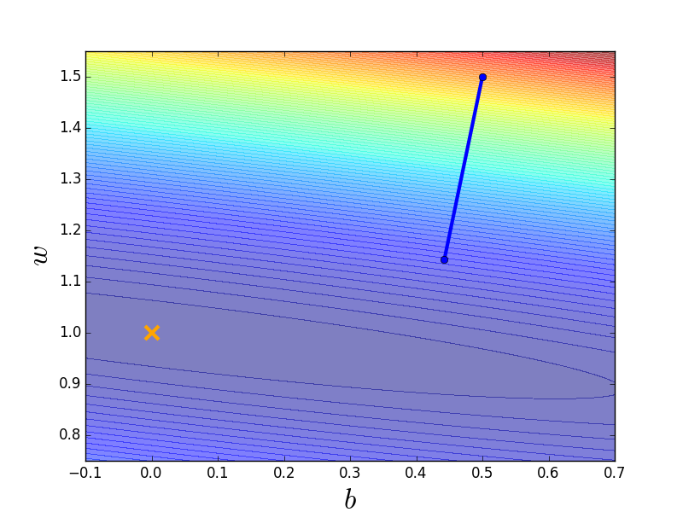

Stochastic Gradient Descent
Stochastic Gradient Descent
Gradient Descent
Update for each example
Update after seeing all examples
If there are 20 examples,
20 times faster.
See all examples
See only one example
See all examples
Notes:
Full?

Slide 20














Mini-batch
We do not really minimize total loss!
Randomly initialize network parameters
x¹
NN
y¹
Pick the 1st batch
$${\hat{y}}^{1}$$
$$l^{1}$$
$$L′=l^{1}+l^{31}+⋯$$
Mini-batch
NN
x³¹
y³¹
$${\hat{y}}^{31}$$
Update parameters once
$$l^{31}$$
Pick the 2nd batch
……
$$L′′=l^{2}+l^{16}+⋯$$
Update parameters once
x²
NN
y²
$${\hat{y}}^{2}$$
$$l^{2}$$
…
Until all mini-batches have been picked
Mini-batch
x¹⁶
NN
y¹⁶
$${\hat{y}}^{16}$$
$$l^{16}$$
one epoch
……
Repeat the above process
Notes:
Each time we update paramters, we have different target -> 不安
Shuffle data, and repeat above process

Slide 21






Mini-batch
Batch size influences both speed and performance. You have to tune it.
Pick the 1st batch
x¹
NN
y¹
$${\hat{y}}^{1}$$
$$L′=l^{1}+l^{31}+⋯$$
$$l^{1}$$
Mini-batch
NN
Update parameters once
x³¹
y³¹
$${\hat{y}}^{31}$$
$$l^{31}$$
Pick the 2nd batch
……
$$L′′=l^{2}+l^{16}+⋯$$
100 examples in a mini-batch
Update parameters once
Batch size = 1
…
Until all mini-batches have been picked
Stochastic gradient descent
Repeat 20 times
one epoch
Notes:
Let’s try it.

Slide 22


Speed
Very large batch size can yield worse performance
Smaller batch size means more updates in one epoch
E.g. 50000 examples
batch size = 1, 50000 updates in one epoch
batch size = 10, 5000 updates in one epoch
166s
1 epoch
17s
10 epoch
166s
Batch size = 1 and 10, update the same amount of times in the same period.
Batch size = 10 is more stable, converge faster
17s
GTX 980 on MNIST with 50000 training examples

Slide 23


Speed - Matrix Operation
……
y₁
W¹
W²
W^{L}
……
y₂
b¹
b²
b^{L}
……
……
……
……
……
x
a¹
a²
y
……
y_{M}
y
x
$$=f\left( \right)$$
Forward pass
(Backward pass is similar)
W^{L}
…
W²
W¹
x
b¹
b²
…
b^{L}
+
+
+
$$σ\left( \right)$$
$$=σ\left( \right)$$
$$σ\left( \right)$$
Notes:
Draw it?

Slide 24











Speed - Matrix Operation
Why mini-batch is faster than stochastic gradient descent?
Stochastic Gradient Descent
$$z^{1}$$
=
$$W^{1}$$
$$x$$
$$z^{1}$$
=
$$W^{1}$$
$$x$$
……
Mini-batch
matrix
Practically, which one is faster?
$$z^{1}$$
$$z^{1}$$
=
$$W^{1}$$
$$x$$
$$x$$

Slide 25
Gradient Descent
Tip 3: Feature Scaling

Slide 26







Feature Scaling
Source of figure: http://cs231n.github.io/neural-networks-2/
$$y=b+w_{1}x_{1}+w_{2}x_{2}$$
$$x_{2}$$
$$x_{2}$$
$$x_{1}$$
$$x_{1}$$
Make different features have the same scaling

Slide 27

Feature Scaling
$$y=b+w_{1}x_{1}+w_{2}x_{2}$$
1, 2 ……
1, 2 ……
100, 200 ……
1, 2 ……
Loss L
Loss L

Slide 28












Feature Scaling
$$x^{1}$$
$$x^{2}$$
$$x^{3}$$
$$x^{r}$$
$$x^{R}$$
$$x_{1}^{1}$$
$$x_{1}^{2}$$
For each dimension i:
$$x_{2}^{1}$$
$$x_{2}^{2}$$
……
……
mean: $m_{i}$
……
……
……
……
……
standard deviation: $σ_{i}$
$$x_{i}^{r}←\frac{x_{i}^{r}−m_{i}}{σ_{i}}$$
The means of all dimensions are 0, and the variances are all 1
Notes:
Can we demo this???????????????
https://standardfrancis.wordpress.com/2015/04/16/batch-normalization/

Slide 29
Gradient Descent
Theory

Slide 30


Question
When solving:
Each time we update the parameters, we obtain $θ$ that makes $L\left(θ\right)$ smaller.
$$θ^{∗}=arg\min_{θ}{L\left(θ\right)}$$
by gradient descent
$$L\left(θ^{0}\right)>L\left(θ^{1}\right)>L\left(θ^{2}\right)>…$$
Is this statement correct?
Notes:
Demo minecraft

Slide 31
Warning of Math

Slide 32

Formal Derivation
L(θ)
Suppose that θ has two variables {θ₁, θ₂}
Given a point, we can easily find the point with the smallest value nearby.
How?
Notes:
You cannot know C(θ) outside the red circle!

Slide 33
Taylor Series
Taylor series: Let h(x) be any function infinitely differentiable around x = x₀.
When x is close to x₀

Slide 34


E.g. Taylor series for h(x)=sin(x) around x₀=π/4
sin(x)=
……
The approximation is good around π/4.

Slide 35
Multivariable Taylor Series
+ something related to (x-x₀)² and (y-y₀)² + ……
When x and y is close to x₀ and y₀

Slide 36
Back to Formal Derivation
Based on Taylor Series:
If the red circle is small enough, in the red circle
L(θ)

Slide 37
Back to Formal Derivation
Based on Taylor Series:
constant
If the red circle is small enough, in the red circle
Find θ₁ and θ₂ in the red circle minimizing L(θ)
L(θ)
Simple, right?
d

Slide 38
Gradient descent – two variables
Red Circle:
(If the radius is small)
Find θ₁ and θ₂ in the red circle minimizing L(θ)
To minimize L(θ)
Notes:
eta

Slide 39
Back to Formal Derivation
Based on Taylor Series:
constant
If the red circle is small enough, in the red circle
Find $θ_{1}$ and $θ_{2}$ yielding the smallest value of $L\left(θ\right)$ in the circle
This is gradient descent.
Not satisfied if the red circle (learning rate) is not small enough
You can consider the second order term, e.g. Newton’s method.
Notes:
Simple, right?

Slide 40
End of Warning

Slide 41



More Limitation of Gradient Descent
http://www.deeplearningbook.org/contents/optimization.html
People believe training stuck because the parameters are near a local minima
local minima
How about saddle point?
Notes:
Optimization neural network is an non-convex optimization problem ……

Slide 42

More Limitation of Gradient Descent
http://www.deeplearningbook.org/contents/optimization.html
People believe training stuck because the parameters are around a critical point
!!!
Notes:
Optimization neural network is an non-convex optimization problem ……
Why?

